Slide 1



Deep Learning Design Patterns with Tensorflow 2.x
Computer Vision Workshop - Data Pipeline #1 Version: May 2020
Repo: github.com/GoogleCloudPlatform/keras-idiomatic-programmer
twitter.com/andrewferlitsch

Slide 2
Data Pipelines
Overview
We will cover in this section we will cover data pipeline part of a e2e production pipeline
Data Formats and Storage
Data Feeding
Data Preprocessing [2nd session]
Data Augmentation [2nd session]

Slide 3
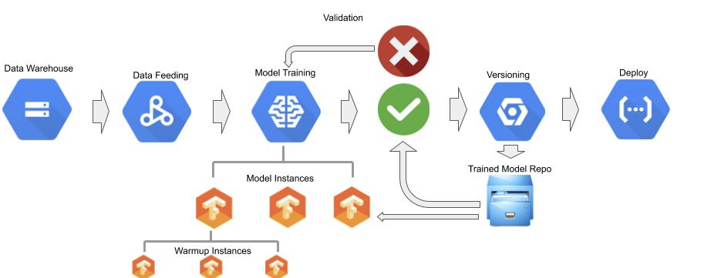
e2e Pipeline

Slide 4
Data Formats
Historically, image data was stored either in:
Compressed image format (e.g., JPG, PNG)
Uncompressed raw image format (e.g., BMP)
A high-dimensional format:
HDF5
DICOM
With TF 2.x, we store image data in TFRecord format.

Slide 5
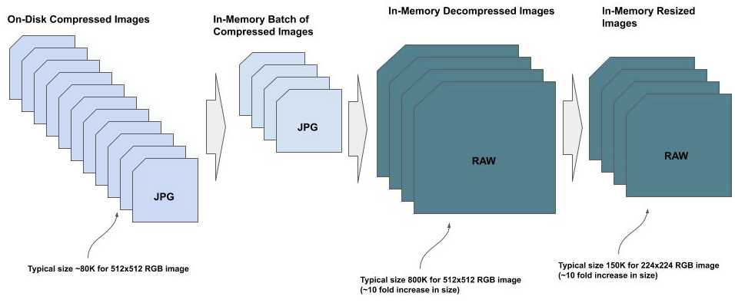
Batches from Disk
When deep learning first became popular for computer vision, we were generally training straight from the raw image data, after being decompressed:
Read the batch of images from disk in a compressed format, like JPG or PNG.
Decompress them in memory,
Resize the images,
Do the image preprocessing, like normalizing the pixel data.

Slide 6
Batches from Disk: Pros/Cons
Pros (Very Easy to do):
Create an index to all the paths of the images on disk and corresponding labels (e.g., CSV index file).
Read the index into memory and randomly shuffle the index.
Draw a batch of images and corresponding labels into memory using the shuffled index file.
Decompress the images.
Resize the decompressed images.
Cons (the steps need to be repeated for every epoch):
The step of drawing data from disk may be I/O bound, specifically dependent on the type of disk storage and the location of the data.
Ideally, one wants the data stored in as fast of a read-access disk operation as possible, and as close (limit network bandwidth) to the compute device doing the training.

Slide 7
Batches from Disk vs Memory: Trade Off
SOTA model with an ImageNet input shape of (224, 224, 3).
50,000 training images, to hold them continuously in memory, you will need 8GB (50K x 150K) of RAM above what you need for the operating system, background applications and model training.
100,000 training images, you would need 16GB of RAM.
One million training images, you would need 160GB of RAM.

Slide 8
Batches from Ram
This strategy eliminates the disk I/O but still does the decompress and resize in memory each time the image appears in a batch.
The average JPEG compression is about 10:1.
100K training images, 2GB of RAM would be enough.
One million training images, 16GB of RAM would be enough.

Slide 9
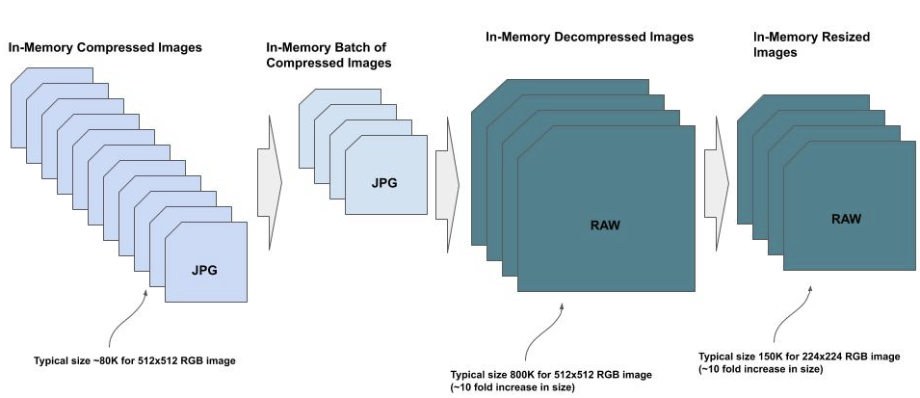
Batches from Ram: Steps
Read all the compressed images and corresponding labels into memory as a list.
Create an index to all the list indices of the images in-memory and corresponding labels.
Randomly shuffle the index.
Draw a batch of images and corresponding labels from memory using the shuffled index file.
Decompress the images.
Resize the decompressed images.

Slide 10
Hybrid Approach
A hybrid approach is to feed training images from both disk and memory. Example:
16GB of memory to hold data
Preprocessed dataset after resizing is 64GB.
Take a large segment of the preprocessed data (8BG in our example) at a time, which has been stratified -- examples match the training data class distribution.
Repeatedly feed the same segment to the neural network as epochs. But each time, we do image augmentation such that each epoch is a unique sampling distribution of the entire preprocessed image dataset.

Slide 11
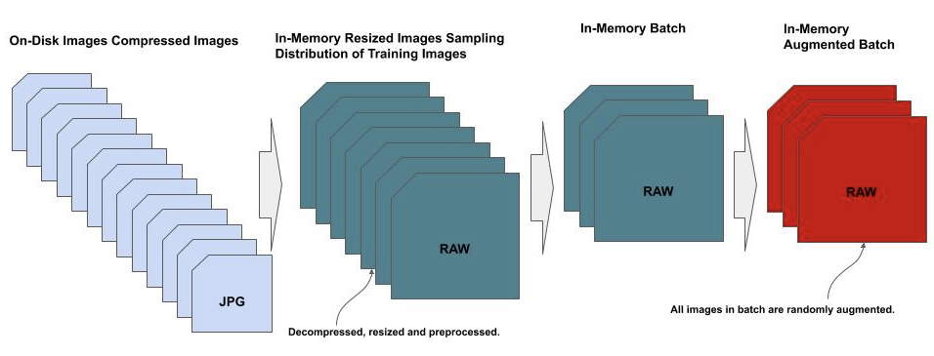
Hybrid Approach: Steps
Create a stratified index to the preprocessed image data on disk.
Partition the stratified index into partitions based on the available memory to hold a segment in memory.
For each segment:
Repeat for a specified number of epochs
Randomly shuffle the segment per epoch.
Randomly apply image augmentation to create a unique sampling distribution per epoch.
Feed the mini-batches to the neural network.

Slide 12
HDF5
HDF5 (hierarchical data format) has been a long-standing common format for storing high dimensionality data, such as images. The format supports dataset and group objects, as well as attributes (metadata) per object.
Some of the benefits of HDF5 for storing image training data are:
Broad scientific use.
Optimized for high-speed data slice access.
Numpy compatible with numpy syntax allows accessing from disk as if in memory.
Hierarchical access.

Slide 13
HDF5 - Basics - Write
The most basic HDF5 representation for a dataset consists of raw (decompressed) image data and corresponding integer label data.
We create two dataset objects, one for the image data and the other for the corresponding labels.
dataset[‘images’] : [...] dataset[‘labels’] : [...]
from tensorflow.keras.datasets import cifar10 (x_train, y_train), (x_test, y_test) = cifar10.load_data() with h5py.File('myfile.h5', 'w') as hf: hf.create_dataset("images", data=x_train) hf.create_dataset("labels", data=y_train)

Slide 14
HDF5 - Basics - Read
To read back the images and labels, we first open the HDF5 for read access. Once opened, we create an iterator for both the datasets images and labels. The HDF5 file handle is a dictionary object and we refer to our named datasets via the dataset name as the key.
Reopen the HDF5 file for read access, and then create an HDF5 iterator for the datasets images and labels, using the keys “images” and “labels”.
In the example, x_train and y_train are aliases for the HDF5 iterators. The data is not actually in memory yet.
hf = h5py.File('myfile.h5', 'r') x_train = hf['images'] y_train = hf['labels']

Slide 15
HDF5 - Array Slicing
HDF5 itertators use numpy syntax and can directly access the data using numpy array slicing, which fetches the data from disk into an in-memory numpy array.
x_batch = x_train[0:100] y_batch = y_train[0:100]

Slide 16
HDF5 - Iterating
Iterate through the HDF5 dataset with a batch size of 50.
Each time we reference the next sequential array slice.
The iterator will then draw 50 images each time from disk and load into x_batch as an in-memory numpy array.
Do the same for the corresponding labels, which are loaded into y_batch as a numpy array.
Pass the batch of images and corresponding labels to the TF.Keras Model method train_on_batch(), which does a single batch update on the model.
examples = 50000 batch_size = 50 batches = examples / batch_size for batch in range(batches): x_batch = x_train[batch*batch_size:(batch+1)*batch_size] y_batch = y_train[batch*batch_size:(batch+1)*batch_size] model.train_on_batch(x_batch, y_batch)

Slide 17
HDF5 - Groups
Create a separate group for each class (label), and corresponding dataset.
Example, two classes: cats and dogs. We create two groups, one for the cats and then the other for dogs. Within both groups we create one dataset for the corresponding images.
Group[‘cats’] Dataset[‘images’]: [...]
Group[‘dogs’] Dataset[‘images’]: [...]
with h5py.File('myfile.h5', 'w') as hf: cats = hf.create_group('cats') cats.create_dataset('images', data=x_cats) dogs = hf.create_group('dogs') dogs.create_dataset('images', data=x_dogs)
Note, we don’t need to store an array of labels anymore, since they are implied by the group name.

Slide 18
HDF5 - Hierarchical
For images are hierarchically labeled, then each group is further partitioned into a hierarchy of subgroups. We use the group attribute to explicitly assign a unique integer value to the corresponding label.
Group[‘cats`] Attribute: {label: 0} Group[‘persian’]: Attribute: {label: 100} Dataset[‘images’]: [...] Group[‘siamese’]: Attribute: {label: 101} Dataset[‘images’]: [...]
Group[‘dogs’] Attribute: {label: 1} Group[‘poodles’]: Attribute: {label: 200} Dataset[‘images’]: [...] Group[‘beagle’]: Attribute: {label: 201} Dataset[‘images’]: [...]
with h5py.File('myfile.h5', 'w') as hf: cats = hf.create_group('cats') cats.attrs['label'] = 0 breed = cats.create_group('persian') breed.attrs['label'] = 100 breed.create_dataset('images', data=x_cats['persian']) breed = cats.create_group('siamese') breed.attrs['label'] = 101 breed.create_dataset('images', data=x_cats['siamese'])

Slide 19
DICOM
DICOM (Digital Imaging and Communications in Medicine ) is ISO 12052 international standard for storing and accessing medical imaging data, such as CT scans and X-rays, and patient information.
This format is broadly used throughout medical research and healthcare systems with an abundance of public de-identified health imaging datasets.
If you are working with medical imaging data, you will need to be familiar with this format.

Slide 20
DICOM
DICOM datasets are extremely large, such as in hundreds of GBs. The author of pydicom provides a small dataset in corresponding repo for demonstration purposes.
In the code example below, we start by importing the pydicom package and getting the author’s test dataset ‘CT_small.dcm’.
import pydicom from pydicom.data import get_testdata_files dcm_file = get_testdata_files('CT_small.dcm')[0]

Slide 21
DICOM - Read Metadata
Next, we read in the dataset and get some basic information about the dataset.
Each dataset contains a large volume of patient information, which can be accessed as a dictionary.
We will show just a few of the fields, most of which in the example have been de-identified.
dataset = pydicom.dcmread(dcm_file) for key in ['PatientID', 'PatientName', 'PatientAge', 'PatientBirthDate', 'PatientSex', 'PatientWeight', 'StudyDate', 'Modality']: print(key, dataset[key])

Slide 22
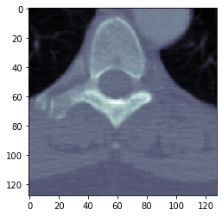
DICOM - Read Image
Extract the image data and display it.
rows = int(dataset.Rows) cols = int(dataset.Columns) print("Image size.......: {rows:d} x {cols:d}, {size:d} bytes".format( rows=rows, cols=cols, size=len(dataset.PixelData))) # plot the image using matplotlib plt.imshow(dataset.pixel_array, cmap=plt.cm.bone) plt.show()

Slide 23
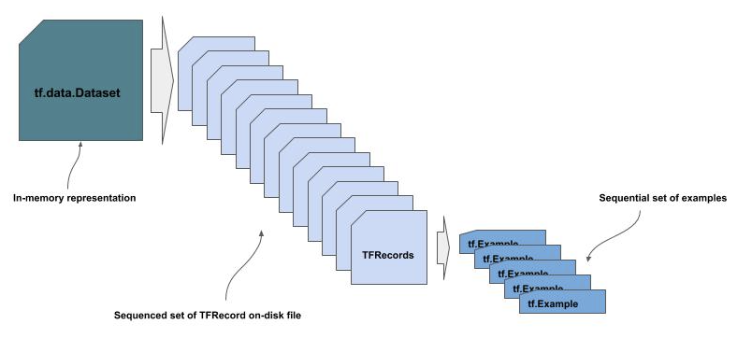
TFRecord
TFRecord is the Tensorflow standard for storing and accessing datasets for training with Tensorflow.
At the toplevel is a tf.data.Dataset. This is the in-memory representation of the training dataset.
Next level is a sequence of one or more TFRecords. These are the on-disk storage of the dataset.
At the bottom level are tf.Example records. Each tf.Example record contains a single data example.

Slide 24
TFRecord - Layout
Convert every data example (image/label) in the training data to a tf.Example.
Serialize these records so they will have fast read access on disk as TFRecord files. The TFRecord files are designed for sequential access, not random access, to minimize read access, since they will be written once, but read many times.
For large amounts of data, the records are generally partitioned into multiple TFRecord files to further minimize read access times specific to the storage device.
While the size of each serialized tf.Example entry, the number of examples, the storage device type and distribution will best determine the partitioning size, the Tensorflow team recommends as a general rule of thumb to be between 100 and 200 MBs each.

Slide 25
tf.Example
The format for tf.Example has similarities to both a Python dictionary and JSON objects.
An example (e.g., image) and corresponding metadata (e.g., label) are encapsulated within a tf.Example class object. A tf.Example object consists of a list of one or more tf.train.Feature entries. Each feature entry can be of one of three data types:
tf.train.ByteList
tf.train.FloatList
tf.train.Int64List
The tf.train.ByteList is used for sequences of bytes or a string.
A tf.train.FloatList is used for 32-bit (single precision) or 64-bit (double precision) float point numbers.
A tf.train.Int64List is used for both 32-bit and 64-bit signed and unsigned integers, and booleans.

Slide 26
tf.Example - Image Data
There are several common practices for encoding image data into tf.Example format, of which share the following in common:
A Feature entry for encoding of the image data.
A Feature entry for the image shape (for reconstruction).
A Feature entry for the corresponding label.
Below is a generic example of defining a tf.train.Example for encoding an image, where the /entries here/ are the dictionary entries for the image data and corresponding metadata.
example = tf.train.Example(features = { /entries here/ })
Note that Tensorflow refers to the format as tf.Example, and the data type as tf.train.Example.

Slide 27
tf.Example - Compressed Encoding
In this code example we create a tf.train.Example object for an image which has not been decoded --i.e. JPG format.
The benefit with this approach is that we use the least amount of disk space when stored as part of a TFRecord.
The drawback is that each time we read a TFRecord from disk while feeding the neural network during training, the image data must be uncompressed -- which is a time vs. space trade-off.
def TFExampleImage(path, label): ''' The original compressed version of the image ''' # read in (and uncompress) the image to get its shape image = cv2.imread(path) shape = image.shape # read in the image a second time for the original bytes with tf.io.gfile.GFile(path, 'rb') as f: disk_image = f.read() # make the example entry return tf.train.Example(features = tf.train.Features(feature = { 'image': tf.train.Feature(bytes_list = tf.train.BytesList(value = [disk_image])), 'label': tf.train.Feature(int64_list = tf.train.Int64List(value = [label])), 'shape': tf.train.Feature(int64_list = tf.train.Int64List(value = [shape[0], shape[1], shape[2]])) })) example = TFExampleImage('example.jpg', 0)

Slide 28
tf.Example - Raw Encoding
In this code example, we create a tf.train.Example entry for storing the uncompressed version of the image in a TFRecord.
This has the benefit of only reading the image from disk once, and it does not need to be uncompressed each time the entry is read from a TFRecord on disk during training.
The drawback is that the size of the entry will be substantially larger than the on-disk version of the image, e.g., 20X as big at 95% compression -- 500K for 25K JPG image.
def TFExampleImageUncompressed(path, label): ''' The uncompressed version of the image ''' # read in (and uncompress) the image image = cv2.imread(path) shape = image.shape # make the record return tf.train.Example(features = tf.train.Features(feature = { 'image': tf.train.Feature(bytes_list = tf.train.BytesList(value = [image.tostring()])), 'label': tf.train.Feature(int64_list = tf.train.Int64List(value = [label])), 'shape': tf.train.Feature(int64_list = tf.train.Int64List(value = [shape[0], shape[1], shape[2]])) })) example = TFExampleImageUncompressed('example.jpg', 0)

Slide 29
tf.Example - Preprocessed Encoding
In this code example, we normalize the pixel data and store the normalized image data.
The advantage to this method is that we do not need to normalize the pixel data each time the entry is read from a TFRecord on disk during training.
The drawback is that now the pixel data is stored as a np.float32, which is four times bigger than the corresponding np.uint8, e.g., 2M for 25K JPG image.
def TFExampleImageNormalized(path, label): ''' The normalized version of the image ''' # read in (uncompress) the image and normalize the pixel data image = (cv2.imread(path) / 255.0).astype(np.float32) #A shape = image.shape #A # make the record return tf.train.Example(features = tf.train.Features(feature = { 'image': tf.train.Feature(bytes_list = tf.train.BytesList(value = [image.tostring()])), #B 'label': tf.train.Feature(int64_list = tf.train.Int64List(value = [label])), #C 'shape': tf.train.Feature(int64_list = tf.train.Int64List(value = [shape[0], shape[1], shape[2]])) #D })) example = TFExampleImageNormalized('example.jpg', 0)

Slide 30
TFRecord - Write
Write a tf.train.Example entry to a TFRecord file on disk.
To maximize the efficiency of writing to and reading back from on-disk storage, the records are serialized to a string format for storing in Google’s protocol buffer format.
with tf.io.TFRecordWriter('example.tfrecord') as writer: writer.write(example.SerializeToString())
tf.io.TFRecordWriter is a function which will write a serialized record to a file in Google’s protocol buffer format.
It is also a common convention when writing a TFRecord to disk, to use the suffix .tfrecord in the file name.
Multiple Examples
with tf.io.TFRecordWriter('example.tfrecord') as writer: # examples is a list of TFRecords, one per image for example in examples: writer.write(example.SerializeToString())

Slide 31
TFRecord - Read
Read each tf.train.Example entry from a TFRecord file in sequential order.
In the example below we assume that the file example.tfrecord contains multiple serialized tf.train.Example entries.
iterator = tf.compat.v1.io.tf_record_iterator('example.tfrecord') for entry in iterator: example = tf.train.Example() example.ParseFromString(entry)
The tf.compat.v1.io.record_interator() creates an iterator object, that when used in a for statement will read into memory each serialized tf.train.Example in sequential order.
The method ParseFromString() is used to deserialize the data into an in-memory tf.train.Example format.

Slide 32
tf.data.TFRecordDataset
Alternatively, we can read and iterate through a set of tf.train.Example entries from a TFRecord file using the tf.data.TFRecordDataset class.
Instantiate a tf.data.TFRecordDataset object as an iterator for the on-disk records.
Define the dictionary feature_description to specify how to deserialize the serialized tf.train.Example entries.
Define the helper function _parse_function() for taking a serialized tf.train.Example (proto) and deserializing it using the dictionary feature_description.
Use the map() method to iteratively deserialize each tf.train.Example entry.
dataset = tf.data.TFRecordDataset('example.tfrecord') feature_description = { 'image': tf.io.FixedLenFeature([], tf.string), 'label': tf.io.FixedLenFeature([], tf.int64), 'shape': tf.io.FixedLenFeature([3], tf.int64), } def _parse_function(proto): ''' parse the next serialized tf.train.Example using the feature description ''' return tf.io.parse_single_example(proto, feature_description) parsed_dataset = dataset.map(_parse_function)

Slide 33
Data Feeding - tf.data
tf.data is a Tensorflow module for constructing a dataset pipeline.
It can construct pipelines from a variety of sources, such as numpy and Tensorflow tensors, both in memory and on-disk.
A dataset pipeline is created as a generator with the class tf.data.Dataset.
tf.data refers to the python module, while tf.data.Dataset refers to the dataset pipeline.

Slide 34
tf.data.Dataset - Numpy
To create an in-memory dataset generator from numpy data, we use the tf.data.Dataset method from_tensor_slices().
The method takes as a parameter the training data which is specified as a tuple: (images, labels).
from tensorflow.data import Dataset from tensorflow.keras.datasets import cifar10 (x_train, y_train), (x_test, y_test) = cifar10.load_data() dataset = Dataset.from_tensor_slices((x_train, y_train))

Slide 35
tf.data.Dataset - Numpy
Next, we iterate through the dataset in batches, like we do when feeding data using the fit() method in TF.Keras and we specify a batch size.
Use the method batch() to set the batch size for the dataset to 128.
Iterate through the dataset and for each batch (x_batch, y_batch) we print the shape.
This will output for each batch: (128, 32, 32, 3) for the image data and (128, 1) for the corresponding labels.
Note how batch is not a property. That is, it does not change the state of the existing dataset, but creates a new generator.
Hence why we assign dataset.batch(128) back to the original dataset variable.
Tensorflow refers to these types of dataset methods as dataset transformations.
dataset = dataset.batch(128) for x_batch, y_batch in dataset: print(x_batch.shape, y_batch.shape)

Slide 36
tf.data.Dataset - Transformations
By default, dataset generators only iterate once through a dataset.
To continuously repeat, as if we have multiple epochs, we use the repeat() method as another dataset transformation.
Since we want every epoch to see a different random ordering of the batches, we use the shuffle() method as another dataset transformation.
dataset = dataset.shuffle(1024) dataset = dataset.repeat() dataset = dataset.batch(128)
The order that the transformations are applied is important.
If we did the repeat() first and then the shuffle() transformation, then on the first epoch the batches would not be randomized.
The dataset transformation methods are also chainable.
dataset = dataset.shuffle(1024).repeat().batch(128)

Slide 37
tf.data.Dataset - Feeding
The value to the shuffle() transformation refers to how many examples from the dataset to pull into memory and shuffle at a time.
For example, if we have enough memory to hold the entire dataset in memory, we set this value to the total number of examples in the training data -- e.g., 50000 for CIFAR-10. That will shuffle the entire dataset at once -- a complete shuffle.
If we don’t, then we need to calculate how much memory we can spare and divide by the size of each in-memory example.
To feed the data to the fit() method we replace x_train, y_train with the dataset instance.
model.fit(dataset, steps_per_epoch=batches, epochs=5, verbose=1)

Slide 38
tf.data.Dataset - TFRecord
To create an on-disk dataset generator from TFRecord files, we use the tf.data method TFRecordDataset().
The method takes as a parameter the path to a single TFRecord file or a list of paths to multiple TFRecord files.
dataset = tf.data.TFRecordDataset('example.tfrecord')
Multiple Files
dataset = tf.data.TFRecordDataset(['example1.tfrecord', 'example2.tfrecord'])

Slide 39
tf.data.Dataset - TFRecord Parsing
Next we tell the dataset generator how to parse each serialized entry in the TFRecord file.
We use the map() method which allows us to define a function for parsing a TFRecord specific example, which will be applied (mapped) to each example, each time the example is read from the disk.
feature_description = { 'image': tf.io.FixedLenFeature([], tf.string), 'label': tf.io.FixedLenFeature([], tf.int64), 'shape': tf.io.FixedLenFeature([3], tf.int64), } def _parse_function(proto): ''' parse the next serialized tf.train.Example using the feature description ''' return tf.io.parse_single_example(proto, feature_description) dataset = dataset.map(_parse_function)
Define the feature_description to describe how to parse the TFRecord specific entries.
Using the earlier example, we assume the layout of our entry is a byte encoded image key/value, an integer label key/value, and a three element integer shape key/value.
We then use the method tf.io.parse_single_example() to parse the serialized example in the TFRecord file based on the feature description.

Slide 40
tf.data.Dataset - TFRecord Example
In this code example we apply the transformation to shuffle and set the batch size to two. We then iterate through the dataset in batches of two examples, and display the corresponding ‘label’ and ‘shape’ key/values.
dataset = dataset.shuffle(4).batch(2) for entry in dataset: print(entry['label'], entry['shape'])
In this output it is showing each batch consists of two examples, labels in the first batch are 0 and 1 and 1 0 in the second batch, and all images are of the size (512, 512, 3).
tf.Tensor([0 1], shape=(2,), dtype=int64) tf.Tensor( [[512 512 3] [512 512 3]], shape=(2, 3), dtype=int64) tf.Tensor([1 0], shape=(2,), dtype=int64) tf.Tensor( [[512 512 3] [512 512 3]], shape=(2, 3), dtype=int64)

Slide 41
tf.data.Dataset - TFRecord Decoding
In this code example we added an additional step in the _parse_function() to decode the image data from a compressed format (JPEG) to an uncompressed format using tf.io.decode_png(). Thus, as each example is read from disk, deserialized, and now the image data decoded.
dataset = tf.data.TFRecordDataset(['example.tfrecord']) feature_description = { 'image': tf.io.FixedLenFeature([], tf.string), 'label': tf.io.FixedLenFeature([], tf.int64), 'shape': tf.io.FixedLenFeature([3], tf.int64), } def _parse_function(proto): ''' parse the next serialized tf.train.Example using the feature description ''' example = tf.io.parse_single_example(proto, feature_description) example['image'] = tf.io.decode_jpg(example['image']) return example dataset = dataset.map(_parse_function)

Slide 42
tf.data.Dataset - TFRecord Raw
In this code example the encoded image data is in an uncompressed format in the TFRecord file. We still need to decode the encoded bytelist into the raw bitmap format using tf.io.decode_raw().
The raw decoded data at this point is a 1D array, so we need to reshape it back into its original shape. After we get the raw decoded data, we get the original shape from the key/value ‘shape’ and then reshape the raw image data using tf.reshape().
def _parse_function(proto): ''' parse the next serialized tf.train.Example using the feature description ''' example = tf.io.parse_single_example(proto, feature_description) example['image'] = tf.io.decode_raw(example['image'], tf.uint8) shape = example['shape'] example['image'] = tf.reshape(example['image'], shape) return example dataset = dataset.map(_parse_function)

Slide 43
THANK YOU FOR WATCHING
Google Cloud AI Developer Relations AI Training

Slide 44
Data Pipeline - Lab Exercise #XX
Optional Code Lab - Get Familiar with Data Pipeline #1
Deep Learning Design Patterns - Workshop - Chapter 9 - 1.ipynb

